Slide 1

WELCOME EVERYONE
TO
OUR DATABASE PRESRNTATION

Slide 2
I am
Jannatul Khould Neju
&
My Project is
Airline
Management System

Slide 3

1. Project Proposal

Slide 4
Sir,
Assalamualaikum, I hope this email finds you well. I am writing to propose the
development of a Airlines Management System that seamlessly integrates Java
Swings,AWT,(JFrame),Netbeans IDE and MySQL.
Project Overview:
This system is designed to streamline and automate various aspects of airline
management, such as ticket booking, Manage flight , and passenger information
management , ticket cancellation. My project is built using Java, with a focus on
object-oriented programming principles and design patterns. We utilize a MySQL
database to store and manage all the data related to the airlines' operations,
including passenger information, and booking records.

Slide 5
Key Features:
1. Admin-Control :
Manage Flight : Admin can manage flight with the details of Flight code, Source,
Destination, Take off, Number of Seat..
Manage Passenger : It has all the details about passenger for flight security.
Ticket Booking : Admins can book tickets for passengers directly through the system.
This feature allows admins to assist passengers in making reservations
and ensures a seamless booking process.
Ticket Cancellation : Admin can easily cancel the ticket with the help
of passenger ID.
2.Database Integration : I propose the use of a robust database (e.g.,
MySQL) to store passenger information, user data,
and order details securely.

Slide 6
3. Technology Stack:
- Frontend: Java Swings, AWT, JFrame
- Database : MySQL
- Security : Implementing best practices for secure transactions and user data .
I would appreciate the opportunity to discuss this proposal further and address any
specific requirements you may have. Please let me know a convenient time for
a meeting, and we can provide a detailed project plan.I look forward to the
possibility of collaborating on this exciting Airlines Management System project.
Best regards,
Jannatul Khould Neju

Slide 7
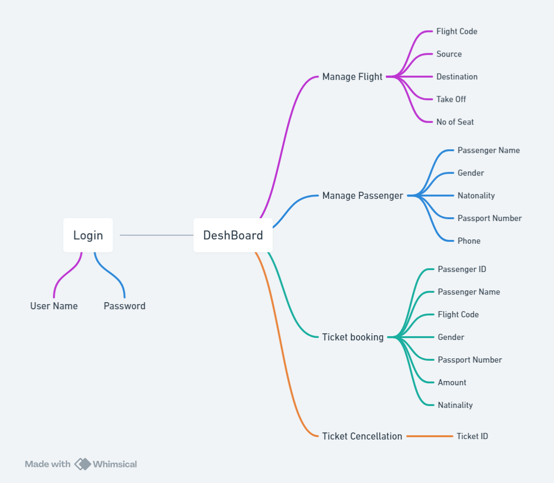
2. Dtabase
Flowchart

Slide 8
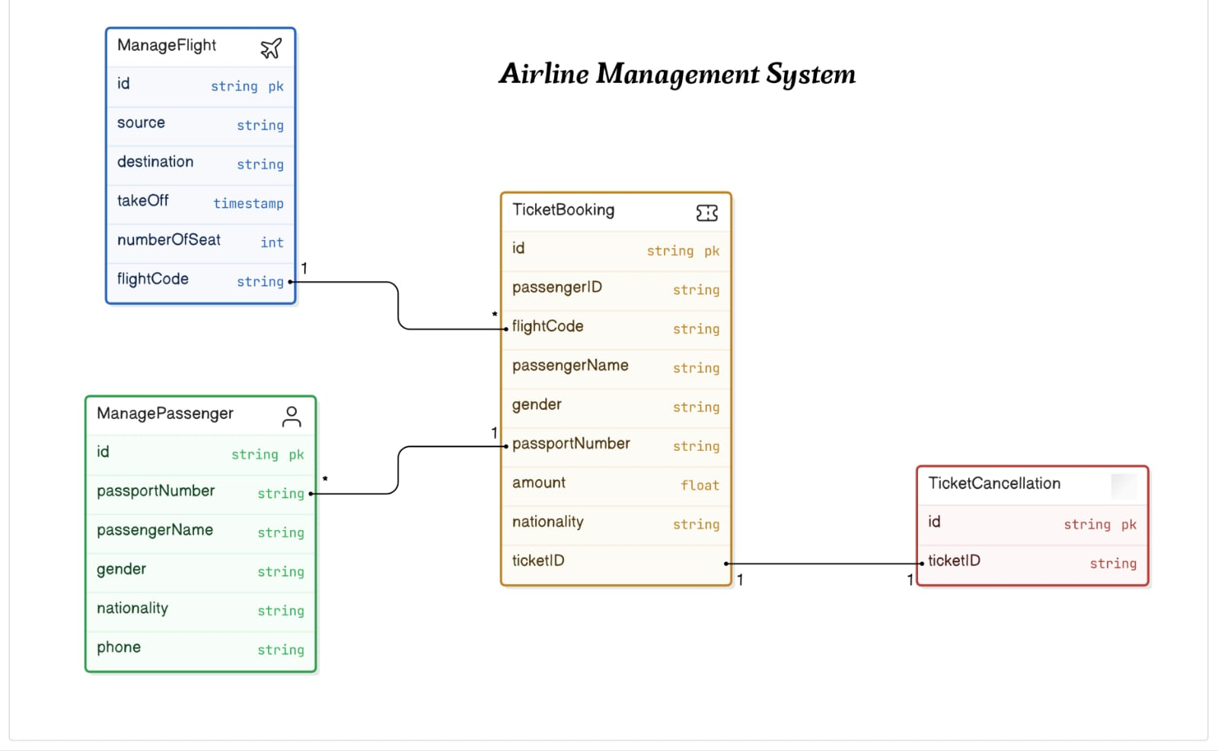
3. Database
Design

Slide 9
The End
Thank You

